Slide 1

Boardventure: Spin, Play, Win
By: Ruhani Jindal and Jolomi Eddi
Notes:
Add visual

Slide 2

Table of Contents
About the Game and Us
How to Play
How to Win
Background and Related Works
Motivation - why we chose this
Problem Statement
Solution Strategy and Implementation
Experimental Framework
Timeline of Activities
Conclusion/summary
Future Work
Our code and programming logic

Slide 3
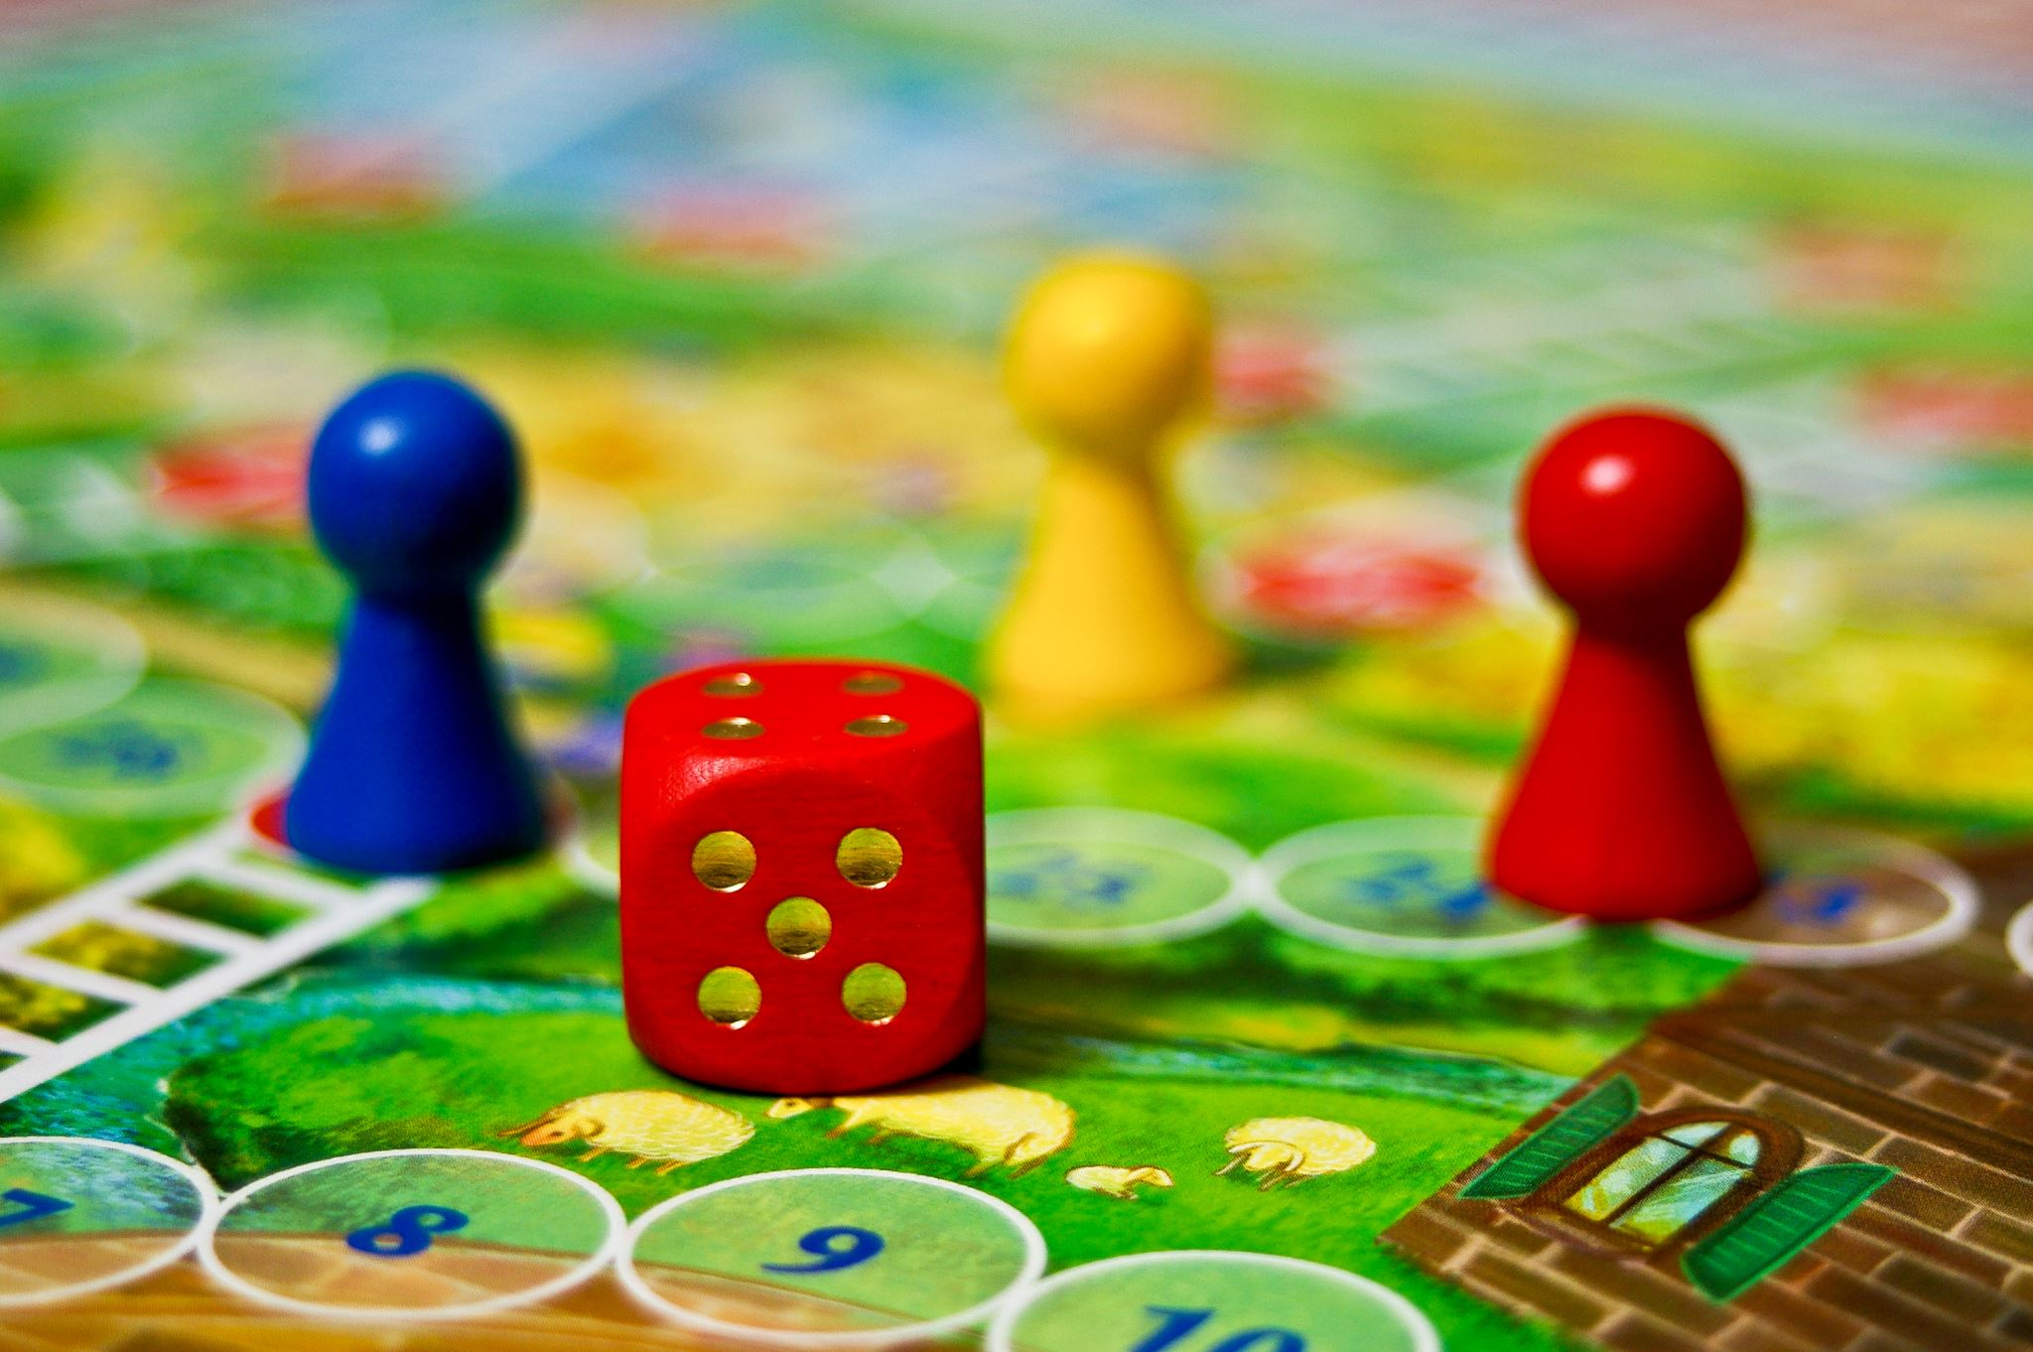
About our game
Game Title: BoardRush
Our Company’s Name: BoardCraft Creations
Notes:
We have made a board game which can have 2-4 players. It can be played online one a single device for all players.

Slide 4

How to Play
Setup: Choose 2 to 4 players, each with a unique colour, and everyone starts with 100 points.
Gameplay: On your turn, spin the spinner to move along the board. As you land on squares, keep an eye out for “STOP” tiles which give you either a point or action card
Action Cards tell you to move extra spaces, switch positions or even take another turn.
Point Cards adjust your score—some boost your points or double them, while others might knock points off. Your score never goes below zero.
Finishing: When you reach the final “FINISH” square, you’re done. The first player to finish earns 400 bonus points, the second 300, then 200, and 100 for last.

Slide 5
How to Win
Player with highest amount of points wins
Gain points through action cards
Gain points by reaching the end of the game the fastest
Notes:
You win the game if you have the highest amount of points by the end. Throughout the game, there are point based cards that you can earn or lose points from. Additionally, players gain points according to which order they finish in.

Slide 6
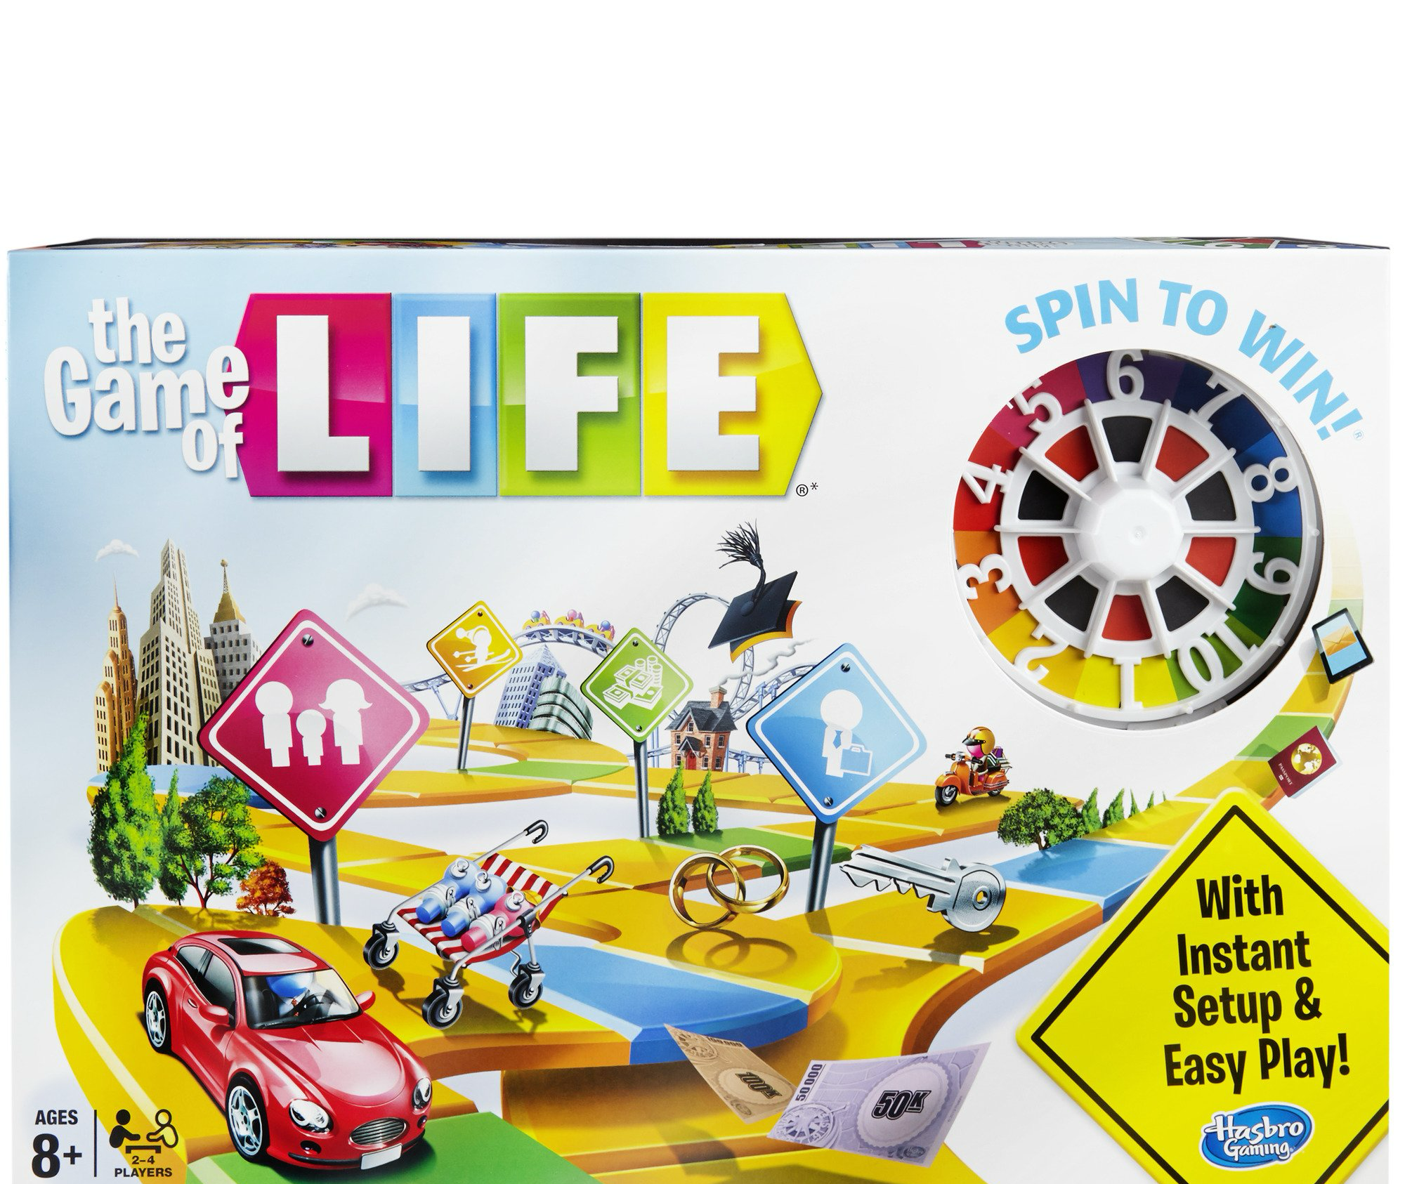
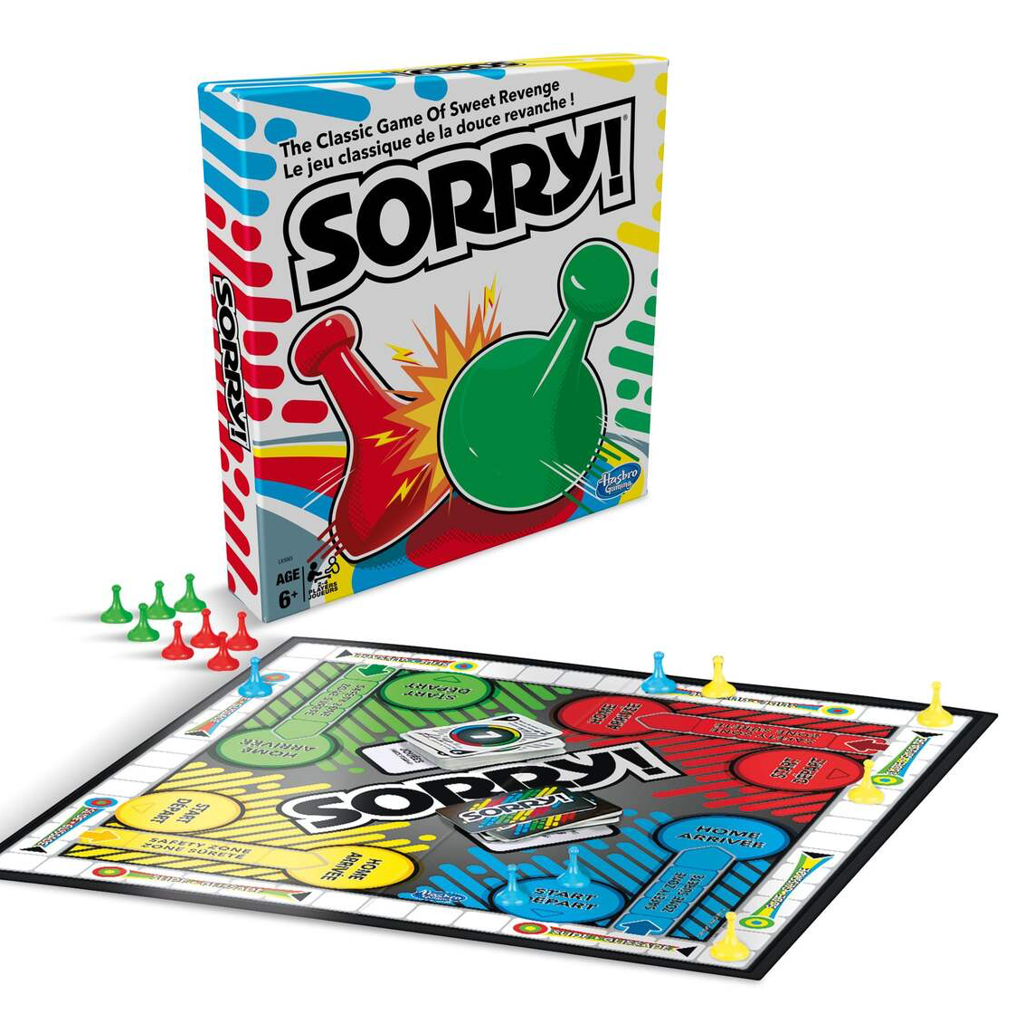
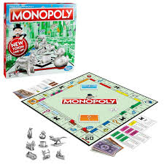
Background and Related Works
These are some of the board games that served as inspiration for our game. These game’s mechanics and features have heavy influence in our project.
Notes:
The Game of Life serves as a strong inspiration for this project due to its structured board game mechanics, player progression system, and emphasis on chance-based movement combined with strategic decision-making. Like The Game of Life, our game involves players taking turns, spinning a wheel to determine movement, and encountering spaces that impact their journey.
One key similarity is the presence of event-based spaces. In The Game of Life, players land on spaces that trigger life events such as career changes, financial gains or losses, and other milestone moments. Similarly, our game features action card spaces, where players engage in creative actions for an element of surprise in each turn. These action spaces introduce unpredictability and variation, making each playthrough unique.
Another important parallel is the currency or point-based progression system. In The Game of Life, financial success is a major factor in determining the winner. Likewise, in our game, players will earn points or in-game currency based on their action cards. Rather than simply racing to the finish, success depends on how well players perform throughout the game.
Additionally, The Game of Life emphasizes a blend of luck and player choice. While movement is determined by chance (via the spinner), the outcomes of life events and financial decisions impact the final standings. Our game adopts a similar structure, where luck influences movement, but action cards determine overall success.
By drawing inspiration from The Game of Life’s turn-based structure, chance-based movement, and event-driven spaces, our game aims to provide an engaging and interactive experience while introducing dynamic mini-games and animations to set it apart.

Slide 7

Motivation – why we chose this
Board games are fun
Good for our programming level
Fun to make
For people who want to play games online with in person people
Notes:
This project was inspired by the game of life and other board games we enjoy playing. The motivation behind this game was to create a fun online game for people who feel bored with traditional board games. It evolved into becoming a game for people who want to play a board game without physical games with them. Our game aimed to provide a fun experience that is accessible to everyone. The game is at a good level for us in terms of the coding and is aesthetically pleasing along with being functional.

Slide 8

Problem Statement
Our goal was to design and develop a fun, engaging board game that targets individuals aged 7-19. We aim to deliver a game that is simple to understand yet filled with enjoyable surprises, challenges, and interactive elements to keep players entertained during their free time.
Notes:
Our goal was to design and develop a fun, engaging board game that targets individuals aged 7-19. We aim to deliver a game that is simple to understand yet filled with enjoyable surprises, challenges, and interactive elements to keep players entertained during their free time.

Slide 9
Solution Strategy and Implementation
Player Movement Animation
Action Cards
Currency & Score Tracking System
Game Conclusion & Winner Determination
Notes:
For the game to feel complete and engaging, we implemented several key mechanics that work together to enhance the overall experience. Each part was designed to make the gameplay more interactive, rewarding, and enjoyable. The key sections of the implementation of our plan were:
a. Player Movement Animation
To enhance the gameplay experience, an animation system has been implemented to visually represent player movement across the board. When a player spins the wheel, their game piece moves step-by-step across the appropriate number of spaces, ensuring a smooth and immersive transition.
b. Action Cards
Certain spaces on the board will feature action cards with unique actions. When a player lands on one of these spaces, they must complete the associated action, often automated, before proceeding. These actions serve as a core gameplay mechanic, adding variety and strategy to the experience.
c. Currency & Score Tracking System
A point or currency system will be implemented to reward players based on their mini-game performance. This system will allow players to accumulate points, which will play a key role in determining the game’s winner.
d. Game Conclusion & Winner Determination
The game will conclude when all players reach the final tile on the board. At this stage, the player with the highest accumulated score or currency will be declared the winner. This scoring system ensures that success is based on both progress and performance throughout the game.

Slide 10

Experimental Framework
We ended up creating a list of all the essential features and elements we wanted in the game, and from there, we took turns tackling different tasks. One major obstacle was that our coding styles differed significantly, leading to clashes between our code when integrating different parts. This resulted in constant debugging every time a new component was added, slowing down our progress. Eventually, we had to simplify our original concept, removing mini-games and focusing on making the core board game functional and fun. We experimented with ideas like integrating a snake-style mini-game but decided against it after realizing it would require more lines of code than the main game itself. In the end, we kept action cards with different types — point cards, automated movement cards, and more — to keep gameplay interesting without overcomplicating development. Despite the setbacks, we managed to finish with a working, enjoyable game.
Notes:
Our approach to this project evolved quite a bit from our original plan. Initially, we aimed to create a more complex game with embedded mini games within the action cards. We divided tasks early on, with Jolomi focusing on making the game visually appealing and working on the design components, while Ruhani worked on building the core game logic. However, as we progressed, we found this division didn't hold up. We ended up creating a list of all the essential features and elements we wanted in the game, and from there, we took turns tackling different tasks.
One major obstacle was that our coding styles differed significantly, leading to clashes between our code when integrating different parts. This resulted in constant debugging every time a new component was added, slowing down our progress. Debugging became one of the most time-consuming parts of our work. Eventually, we had to simplify our original concept, removing mini-games and focusing on making the core board game functional and fun. We experimented with ideas like integrating a snake-style mini-game but decided against it after realizing it would require more lines of code than the main game itself. In the end, we kept action cards with different types — point cards, automated movement cards, and more — to keep gameplay interesting without overcomplicating development. Despite the setbacks, we managed to finish with a working, enjoyable game.

Slide 11
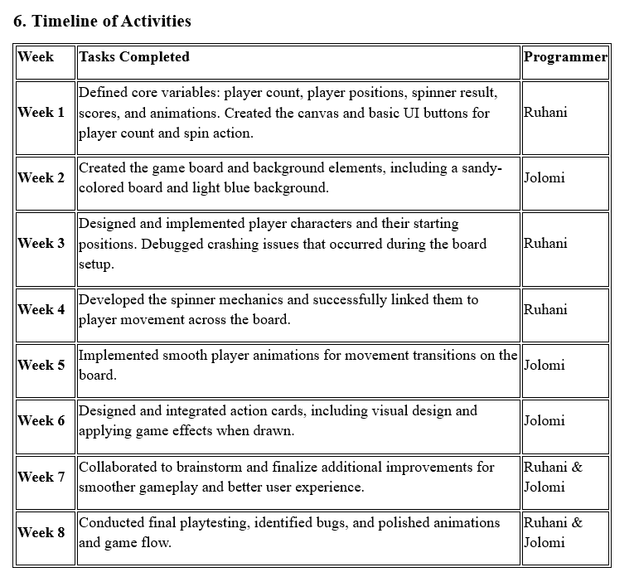
Timeline of Activities
Notes:
Ruhani

Slide 12
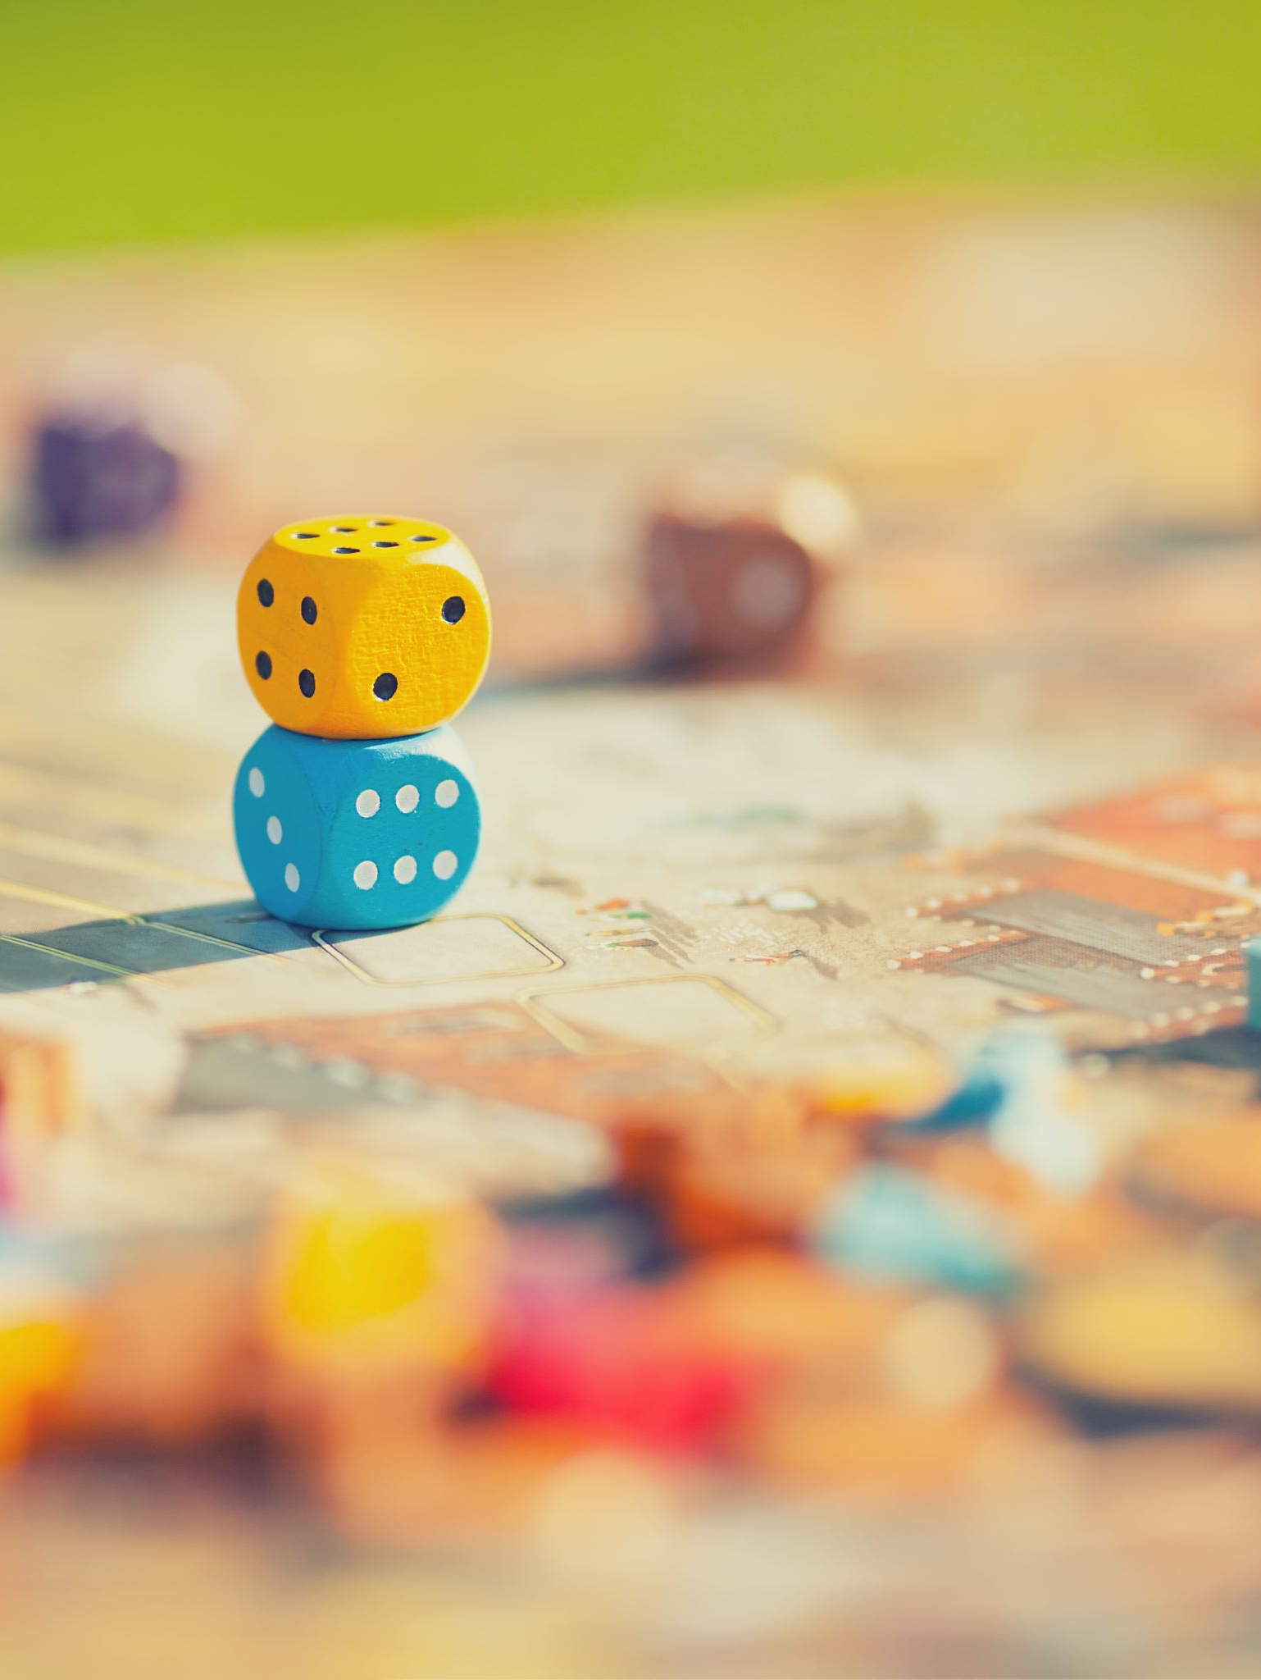
Future work
In the future we could work on fully expanding on our original idea of having mini-games within our board game and fully achieving what was in out original plan

Slide 13
Results
We made a fully functioning boardgame where:
The Game Logic is Functional
Valid Gameplay and Win Condition
Advancement through Action Cards
User Interface
Notes:
Results
We have made a fully functional board game where:
The Game Logic is Functional: The players should be able to play a full game against each other. They will spin the spinner and work through the action cards to gain points. The player with most points at the end will win.
Advancement through Action Cards: Every time an action card pops up, there will be a fun activity the players can play and earn points from.
Valid Gameplay and Win Condition: The game will ensure that the game ends when all players reach the end of the board. Then, the statistics will be shown and there will be a celebratory page once the game is complete with an option to restart.
User Interface: A simple and good-looking game experience
By implementing this project, we have demonstrated our understanding of what we have learned in our DMII class.

Slide 14

Thank you for listening! ☺

